Slide 1


SMART PARALYSIS PATIENT HEALTHCARE SYSTEM
USING RASPBERRY PI
PRESENTED BY:
KARTHICK RAJA D (721820121023)
SANTHOSH N (721820121041)
THANGA GANESH P (721820121049)
SWATHI G (721820121701)
UNDER THE GUIDANCE:
Mrs.S.SARITHA M.E.,
ASSISTANT PROFESSOR

Slide 2
OBJECTIVE
Smart Paralysis Patient Healthcare System using Machine Learning Model" is to design and implement an intelligent healthcare solution tailored for individuals with paralysis. This system aims to leverage machine learning algorithms to monitor, analyze, and predict the health status of paralysis patients, providing timely insights for personalized care and early intervention

Slide 3
ABSTRACT
We come across hospitals and NGOs serving paralytic patients who have their whole or partial body disabled by the Paralysis attack. These people in most cases are not able to convey their needs as they are neither able to speak properly nor do they convey through sign language due to loss in motor control by their brain. In such a situation we propose a system that helps disabled person in displaying a message over the monitor display by just simple motion of any part of his body which has motion abilities.

Slide 4
This system also takes care of the situation where in no one is present to attend the patient and thus sending a message through GSM of what he wants to convey in SMS. There are several instruction of movement gesture sensors presented in the paper in order to assist health officer in helping the paralyzed patient to complete their needs. The user now just needs to tilt the device in a particular angle to convey the message. Thus, by tilting device one can convey message easily. So, this system can help them out to convey a message.

Slide 5
INTRODUCTION
Paralysis is the inability to move muscles on your own and with purpose. It can be temporary or permanent. The most common causes are stroke, spinal cord injury, and multiple sclerosis. Paralysis can be a complete loss of movement known as plegia, or a significant weakness called paresis. Paralysis is most often caused by damage in the nervous system, especially the spinal cord. Other major causes are stroke, trauma with nerve injury, poliomyelitis, cerebral palsy, peripheral neuropathy, Parkinson's disease, ALS, botulism, spina bifida, multiple sclerosis, and Guillai-Barre syndrome. For example, monoplegia/ mono paresis is complete loss of movement or weakness of one limb. Hemiplegia/hemiparesis is complete loss of movement or weakness of arm and leg on same side of the body.

Slide 6
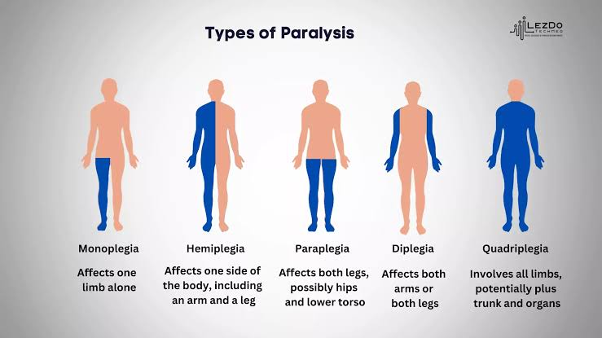

Slide 7
What are the patterns of muscle paralysis?
Diplegia:
Paralysis occurs on the same area on both sides of the body.
Hemiplegia:
Paralysis affects one side of the body (an arm and a leg on the same side).
Monoplegia:
You can't move one limb (arm or leg).
Paraplegia:
Paralysis affects both legs and sometimes the torso.
Quadriplegia:
paralysis affects the total human body.

Slide 8
PROBLEM STATEMENT
Paralysis, whether caused by spinal cord injury, stroke, or other neurological conditions, presents a complex set of challenges for both patients and healthcare providers. While medical advancements have improved survival rates and quality of life for paralysis patients, there remains a pressing need for a comprehensive healthcare system tailored specifically to address the multifaceted needs of this population.

Slide 9
EXISTING METHOD
Real time monitoring Guillain of patient using Node MCU Upload data on cloud No precaution steps can be taken, action taken at the time of malware happens

Slide 10
PROPOSED SYSTEM
Using Machine learning model to train the data Precaution steps are taken based on ML prediction Monitoring of data using Raspberry Pi

Slide 11
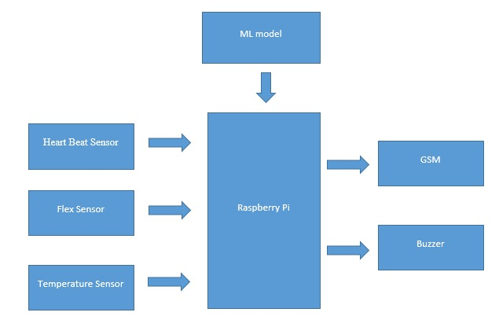
BLOCK DIAGRAM

Slide 12
HARDWARE REQUIREMENTS
SOFTWARE REQUIREMENTS
Raspberry pi
Heartbeat sensor
Flex sensor
Temperature sensor
GSM
Buzzer
Language – Python
Tool – Python IDLE

Slide 13
SYSTEM ANALYSIS
The system integrates wearable devices, sensors, and a cloud-based platform to collect and analyze patient data. Machine learning models process this data to identify patterns, trends, and anomalies related to the patient's health. The analysis includes vital signs monitoring, mobility patterns, and potential complications associated with paralysis. The system ensures secure data transmission and adheres to privacy regulations, maintaining the confidentiality and integrity of patient information.

Slide 14
ADVANTAGES
The proposed system offers several advantages, including real-time health monitoring, early detection of potential health issues, and personalized care plans. By employing machine learning models, the system can adapt and learn from patient data, enhancing its predictive capabilities over time. This leads to improved healthcare outcomes, reduced hospitalizations, and an overall enhancement in the quality of life for paralysis patients and their caregivers.

Slide 15
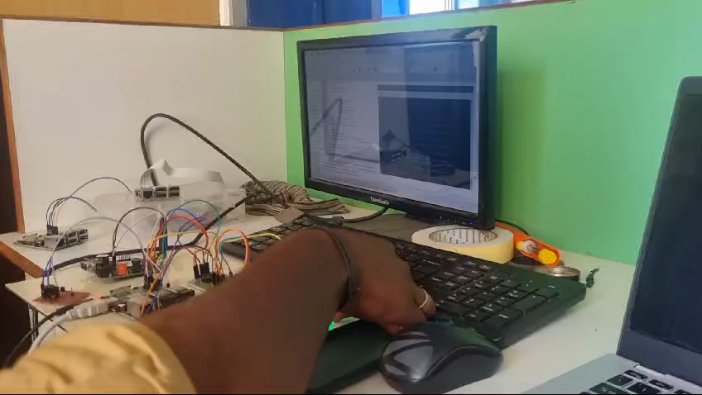
OUTPUT VIDEO

Slide 16
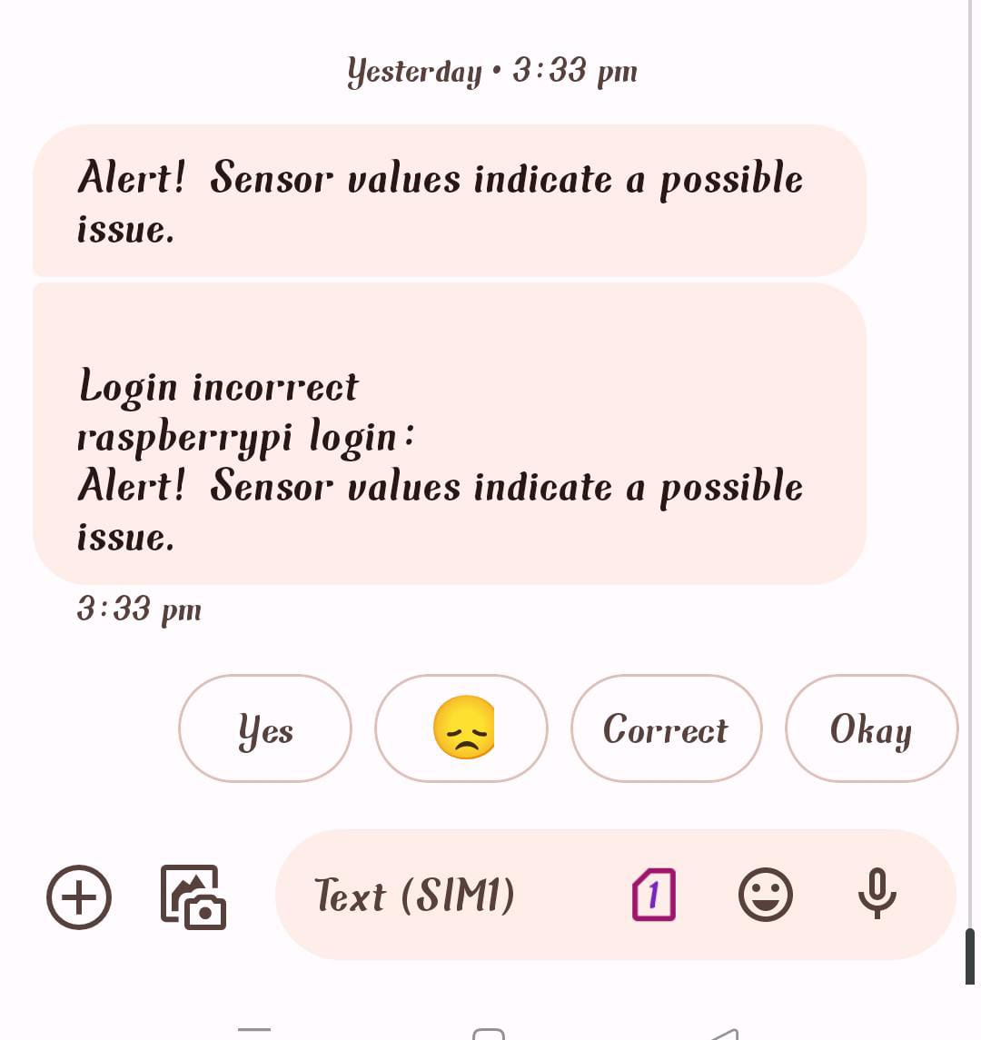
OUTPUT

Slide 17
CONCLUSION
Smart Paralysis Patient Healthcare System using Machine Learning Model" presents a holistic and proactive approach to paralysis patient care. By harnessing the power of machine learning, the system offers a dynamic and personalized healthcare solution, improving patient outcomes and easing the burden on caregivers and healthcare facilities. The integration of advanced technologies not only enhances the efficiency of healthcare delivery but also promotes a more patient-centric and preventative healthcare paradigm for individuals living with paralysis.

Slide 18
REFERENCES
[1] E. N. Ganesh, "Health Monitoring System using Raspberry Pi and IOT" published in Oriental Journal of Computer Science and Technology, Volume 12, No 1,2019
[2] Shubham Banka, Isha Madan, S.S. Saranya, "Smart Healthcare Monitoring using IOT" published in International Journal of Applied Engineering Research, Volume 13, No 15,2018
[3] Abhijeet Botre, "Assistance system for paralyzed" published in International Journal Of Innovative Research In Electrical, Electronics, Instrumentation And Control Engineering, Volume 4,1ssue 5, 2016.
[4] ProsantaGopeet al. 2016. BSN-Care: A Secure IoTbasedModern Healthcare System Using Body Sensor Network. IEEE Sensors Journal. 16(5): 1368-1376.
[5] Tzonelih Hwang et al. 2016. Untraceable Sensor Movement in Distributed IoT Infrastructure.IEEE Sensors Journal. 15(9): 5340-5348.

Slide 19
THANK YOU

